Slide 1
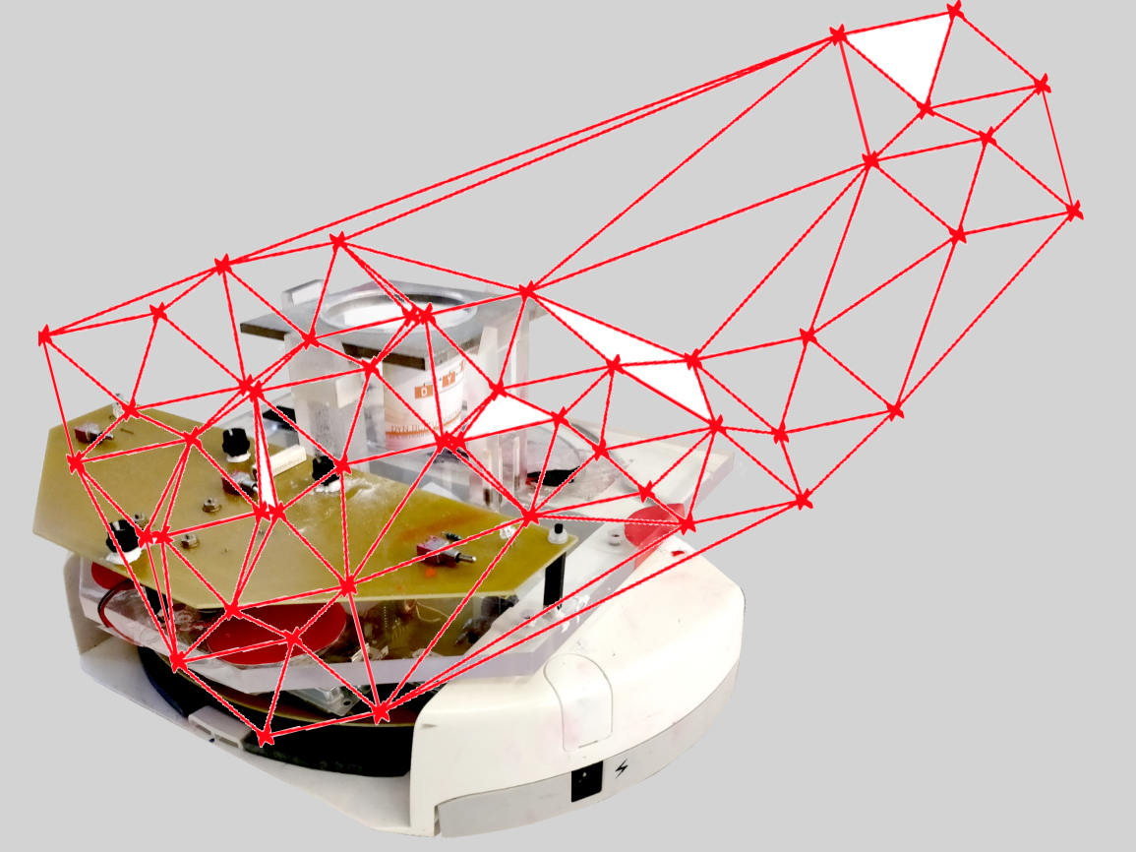
Project group SS18
Development of local positioning system for a pipe-less plant

Slide 2
Task since last meeting
Research about different Tracking Systems

Slide 3
Topics of Research
Triangulation
Stefan Rottstegge
Pattern Recognition
Medhini Rajagopal Balamurugan
Map-Based positioning
Abdulrahman Abouelkhair
Radio frequency identification (RIFD)- Based Indoor Positioning Technology
Stephan Vette

Slide 4
Agenda
Theory of the research topic
Implementation in the Pipe-less Plant
Properties of quantities
Conclusion

Slide 5
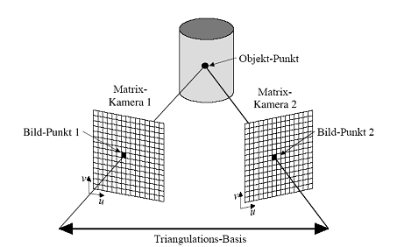
Theory of Triangulation
Geometrical method of 3D Object-Data estimation.
Two stations with known distance
Exact angular measurement of triangle via. Trigonometric functions

Slide 6
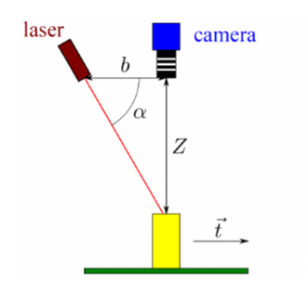
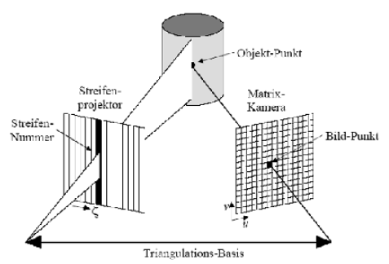
Active vs. Passive Triangulation
Active Triangulation needs at least one structured light source (e.g. Laser) and one Sensor (e.g. Camera)

Slide 7
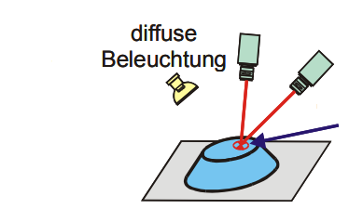
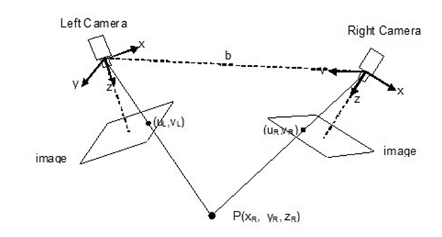
Active vs. Passive Triangulation
Passive Triangulation works with diffuse light (e.g. daylight) and two cameras.

Slide 8
Compare
 | Aktive | Passive
Positive | Upgrade to USB 3.0 possible or keep the current camera Upgrade to higher resolution possible Easy detection of a laser point | No fish eye problem Low cost Upgrade to USB 3.0 possible Upgrade to higher resolution possible
Negative | New Laser technology needed High costs for several Laser (one per AGV) Laser needs to move since AGVs are moving | Light dependent May need a new concept for orientation determination Limited range of observation

Slide 9
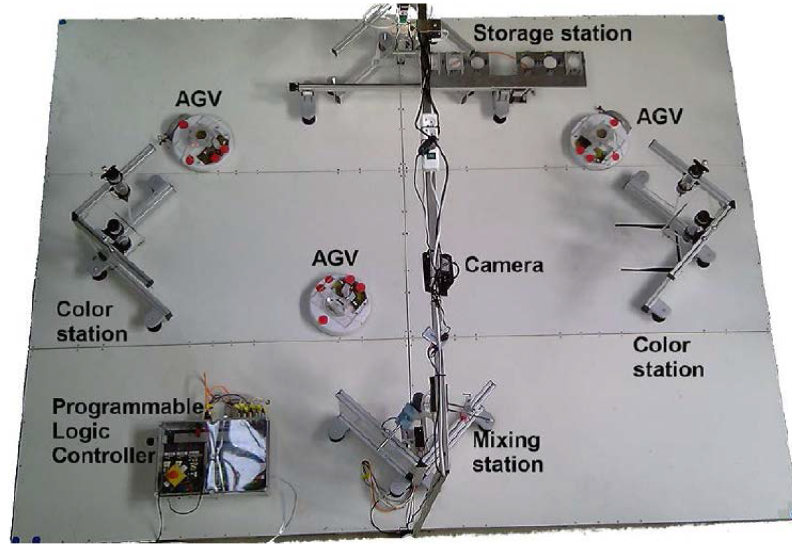
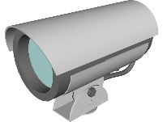
Implementation in the Plant

Slide 10

Mobile Robot Localization based on Pattern Recognition

Slide 11
Theoretical Background
Estimation of the robot position in the indoor environment based using on-board sensors, namely a webcam and IMU.
Based on Ceiling pattern recognition
Markov Localization

Slide 12
Markov Localization
Involves 2 steps:
Prediction Step : combines IMU (Inertial Measurement Unit) data and image parameters to compute the attitude of the robot
Update Step : calculated by measuring the distance to possibly visible ceiling lights.

Slide 13
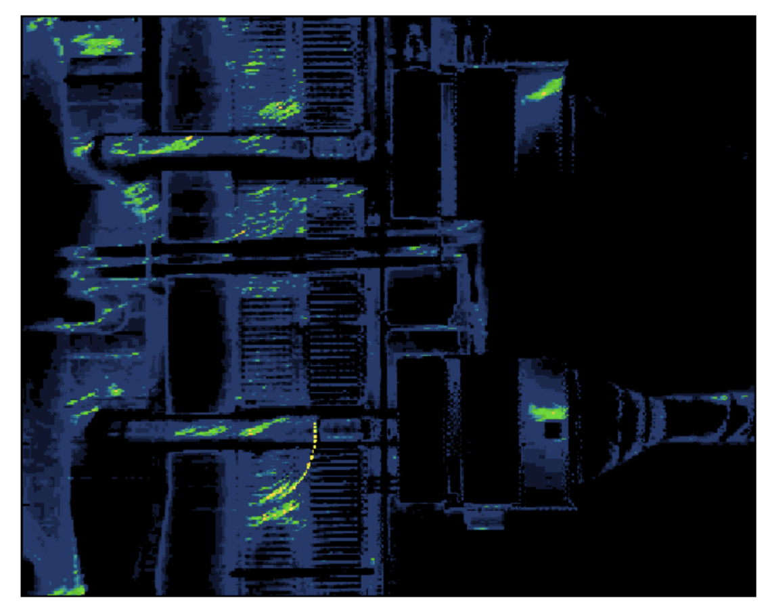
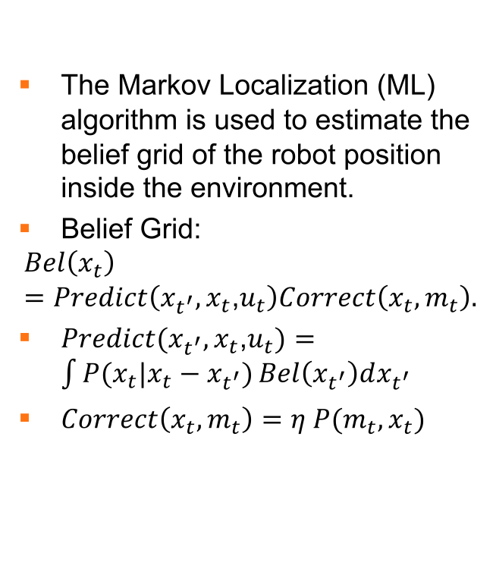
Markov Localization
The Markov Localization (ML) algorithm is used to estimate the belief grid of the robot position inside the environment.
Belief Grid:
$$Bel\left(x_{t}\right)=Predict\left(x_{t^{′}},x_{t}\text{,}u_{t}\right)Correct\left(x_{t},m_{t}\right).$$
$Predict(x_{t^{′}},x_{t}\text{,}u_{t})=\int{P(x_{t}|x_{t}−x_{t^{′}})}Bel\left(x_{t^{′}}\right)dx_{t^{′}}$
$Correct\left(x_{t},m_{t}\right)=η P(m_{t},x_{t})$
Sum of probabilities during the convergence shows preliminary
estimates and the final covered path.Blue and black areas have
lower belief and green and yellow areas have higher belief.

Slide 14
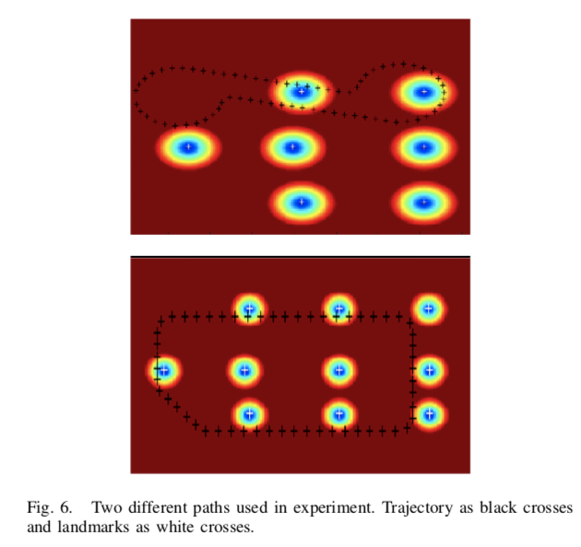
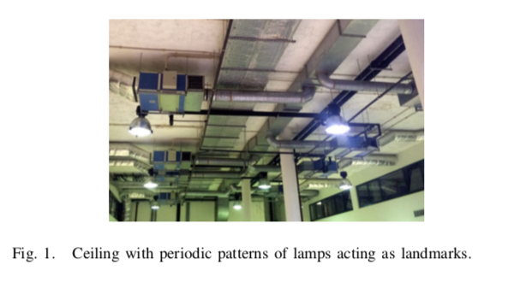
Experimental Setup
Fig.2 Ceiling with periodic patterns of lamps acting as landmarks.
Fig.3 Two different paths used in experiment.
Trajectory as black crosses
and
landmarks as white crosses

Slide 15
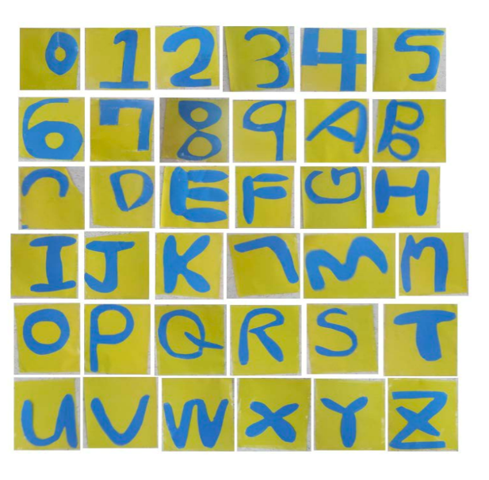

Alternative
Using QR codes or other Patterns on ceilings as either Guidance or Landmarks!
Opting for other patterns on the AGV itself instead of LED pattern to overcome existing drawback.

Slide 16
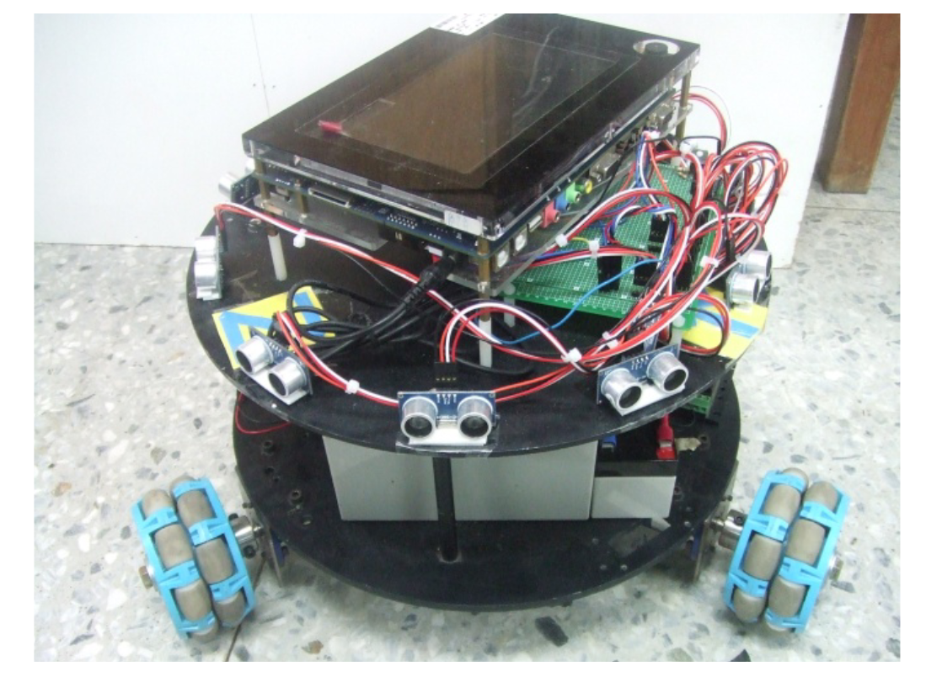
Implementation
Placing camera and IMU(optional, required if Markov Localization is used) on the AGV itself.

Slide 17
Overview
Advantages:
The ceiling is usually immune to changes, as a reference and implement landmarks
No more fish eye problem.
Disadvantages:
Complex and cost intensive.

Slide 18
References
Shih,C.-L. and Ku, Y.-T. (2016) Image-Based Mobile Robot Guidance System by Using Artificial Ceiling Landmarks. Journal of Computer and Communications,4, 1-14.
http://dx.doi.org/10.4236/jcc.2016.411001
Mobile robot localisation for indoor environments based on ceiling pattern recognition by Francisco Dias, Hanna Scha ̈fer, Leonardo Natal, Carlos Cardeira IDMEC/LAETA, Instituto Superior Tecnico, Universidade de Lisboa1049-001 Lisboa, Portugal

Slide 19

RFID Indoor Positioning

Slide 20
Theoretical Background
Radio-frequency identification
Uses radio waves to transmit the identity and localization
Three systems: passive, semi-passive and active
Contains tags, one or multiple reader and a host PC
Passive: The tag gets energy from the field (reader)
Relation between signal strength and distance between tag and reader

Slide 21
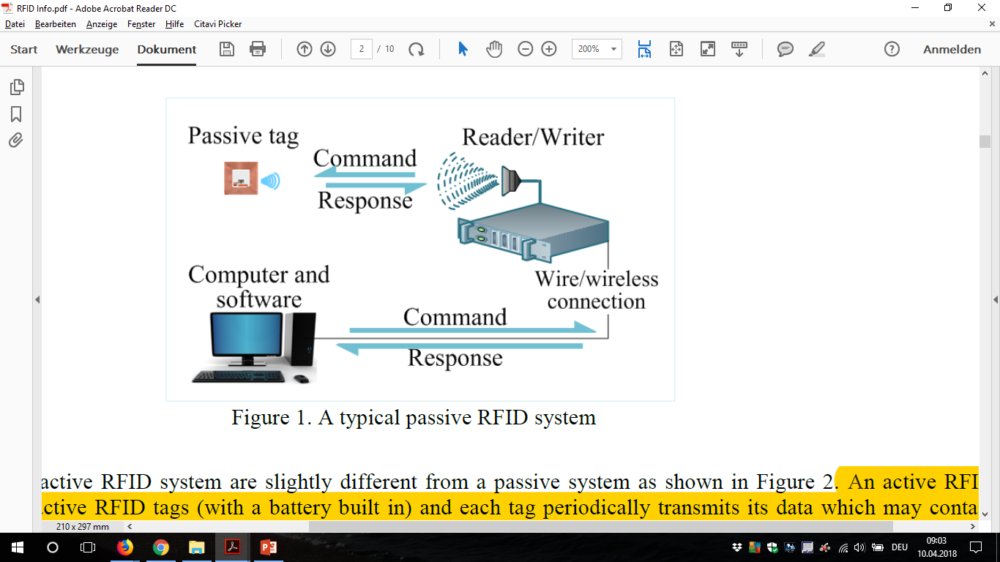
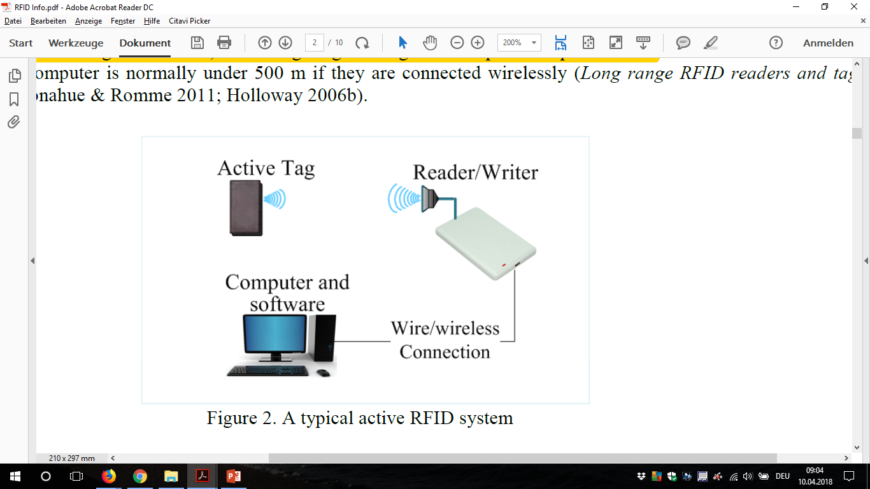
Theoretical Background
Passive Active
Power for the passive tag is provided by the reader
Active systems can simultaneously read several tags and its reading range is longer

Slide 22
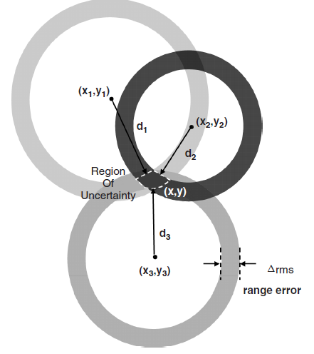
Implementation in our project
System 1 System 2
3 reader 1 reader at robot
1 active tag at robot many passive tags

Slide 23
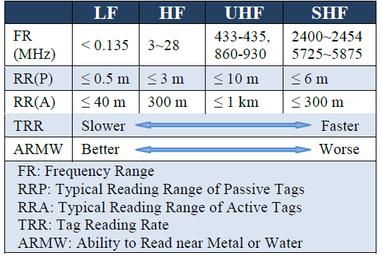
Quantities
Speed
Accuracy
Around 10 cm
Ability to implement
- everything would be complitly new

Slide 24
Summary
Pro
Low cost of the device (no idea what a complete system will cost)
Location and identification possible
No problems with light
Cons
No experience
Not yet found a project, that is completely comparable to ours
Reflection due to metal

Slide 25
Map-Based Localization
SLAM
Mapping
Localization
Path Planning
Control
Laser Scan
AMCL
Monte Carlo
Localization
Map
Pose Estimation
Odometry
Global and
Local Planner

Slide 26
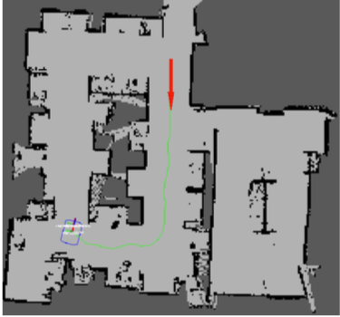
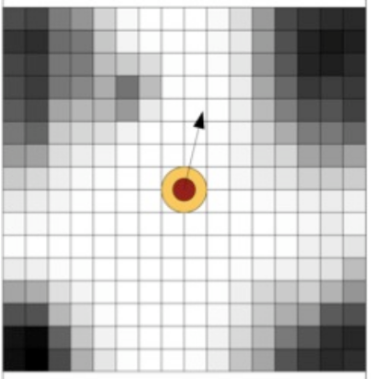
Types of Maps
Global Map
Local Map

Slide 27
SLAM
SLAM (Simultaneous Localization and Mapping) is a technique used in mobile robotics in which a robot builds a map of an unknown environment, keeping at the same time track of its localization in this environment. It was original developed in (Leonard e Durrant-Whyte 1991).
Grid Mapping
Landmark based

Slide 28
SLAM
It is said that the SLAM consists in making the robot to answer two questions:
Where am I?
What does the world look like?

Slide 29
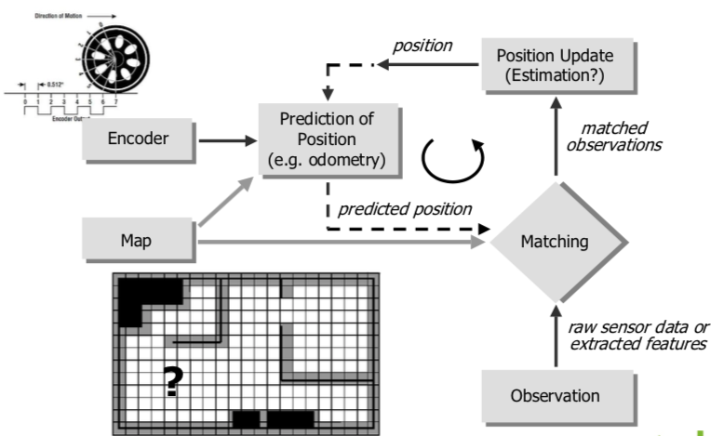
Adaptive Monte Carlo Localization

Slide 30
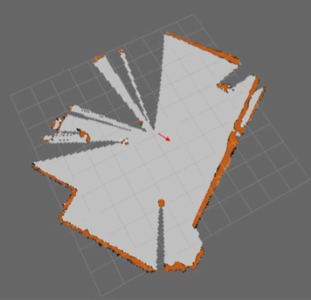
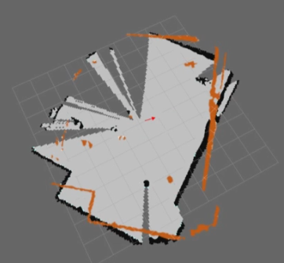
Orientation Correction
Robot Orientation
Correction with Global map

Slide 31
Global Planner
The global planner consists of a functional component in which, given a representation of the environment including known obstacles (e.g., a map), a current position and a goal position, it finds a free path from the current position to the goal position, i.e., a global plan. Nevertheless, it has to make some assumptions, such as a holonomic motion 4 , a point representing the robots position, a static and non-dynamic environment.

Slide 32
Local Planner
The local planner is generally in charge of obstacle avoidance and driving the robot to a local goal position. Thus, for the local planner the environment can change dynamically and not be entirely modeled. The local planner may modify or replan a globally generated plan and move the robot towards a goal without a global plan. It relies on information about the goal or sub-goal on the global path, local context information (localization) and recent sensor information (local map)

Slide 33
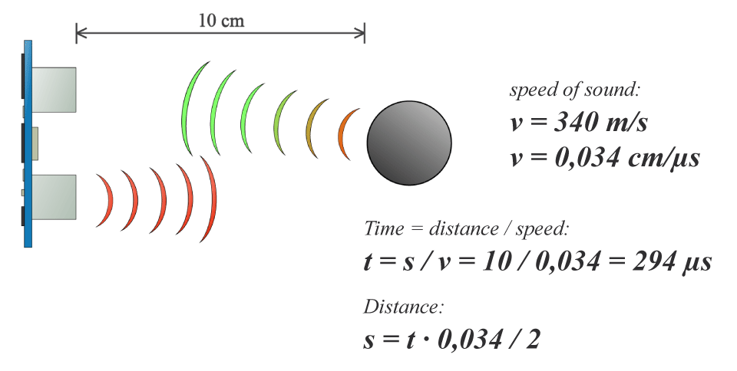
HC-SR04 Ultrasonic Sensor

Slide 34
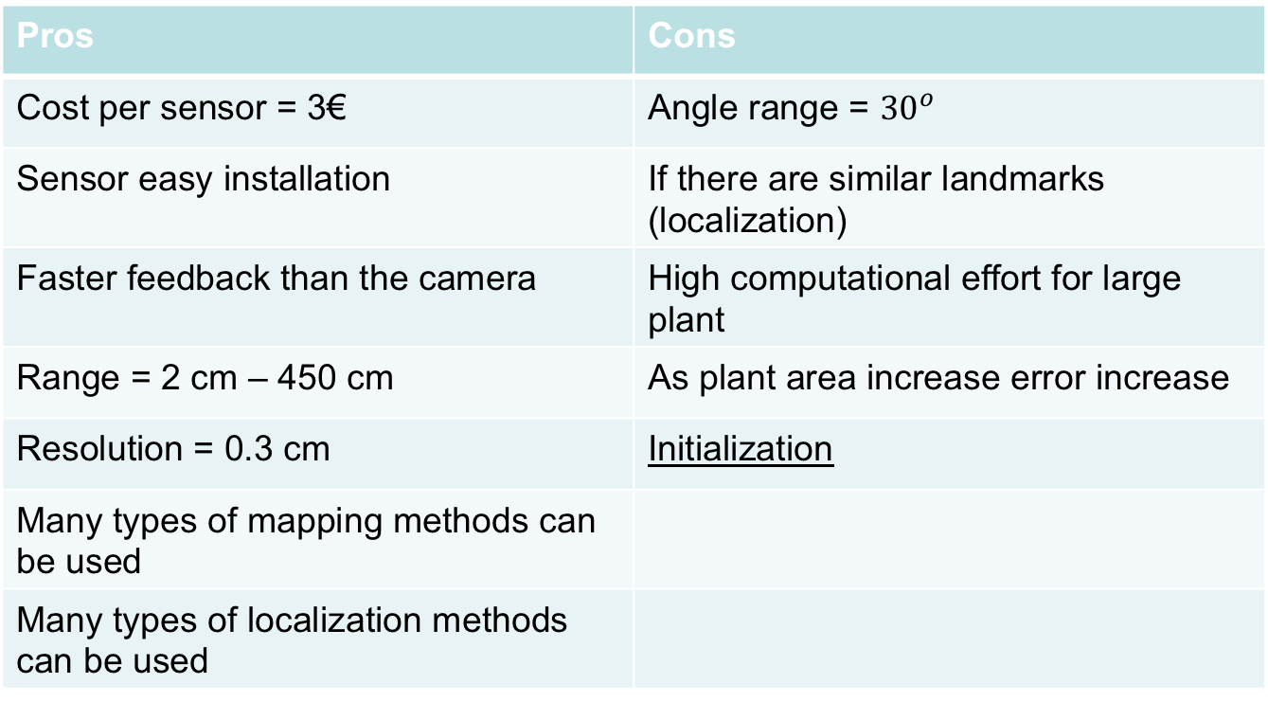
Pros and cons
Pros | Cons
Cost per sensor = 3€ | Angle range = ${30}^{o}$
Sensor easy installation | If there are similar landmarks (localization)
Faster feedback than the camera | High computational effort for large plant
Range = 2 cm – 450 cm | As plant area increase error increase
Resolution = 0.3 cm | Initialization
Many types of mapping methods can be used
Many types of localization methods can be used

Slide 35
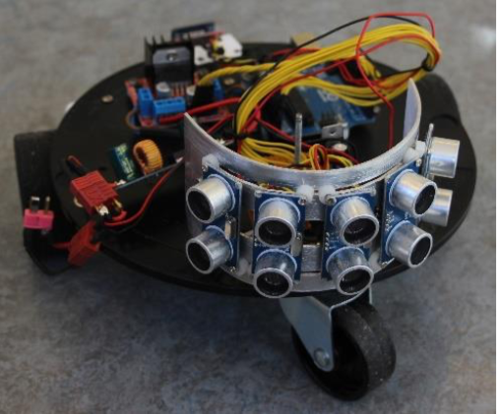
Example

